Slide 1
Hackathon- CoVID-19
Done by,
Amrit Paul

Slide 2
TOC
Overview
Problem Statement
Flow diagram
Results
Scope for improvement

Slide 3
Overview
Coronavirus disease 2019 (COVID-19) is an infectious disease caused by severe acute respiratory syndrome coronavirus 2 (SARS-CoV-2)
The disease was first identified in December 2019 in Wuhan, the capital of China's Hubei province, and has since spread globally, resulting in the ongoing 2019–20 coronavirus pandemic.
As of 25 April 2020, more than 2.86 million cases have been reported across 185 countries and territories, resulting in more than 201,000 deaths. More than 811,000 people have recovered.

Slide 4
Problem Statement
03
Identify if people are following social distancing with the help of a camera and object detection algorithm. If people are found to be breaking the rules, high pitch alarms and sounds can be made use to make them attentive. There can also be provisions to let the authorities know if there are any large scale social gatherings. Can you make this happen? Come up with a Proof of Concept.

Slide 5
Flow Diagram
1
2
3
4
Pedestrian Detection and Tracking
Establish Social Distance
Crowd detection
Violator Notifications

Slide 6
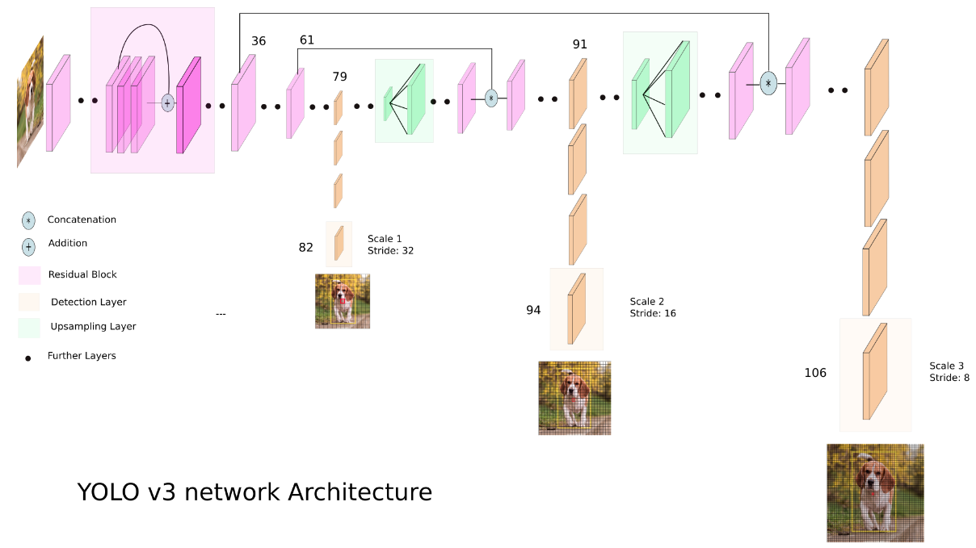
Pedestrian Detection and Tracking
The model used was YOLOv3 using transfer learning on Darknet with Pytorch framework. It is a real-time model which takes 0.1s per frame and utilizes less than 2GB of VRAM on a GPU.
The tracking algorithm used was SORT (Simple Online and Realtime Tracking) which is a rudimentary visual multiple object tracker which incorporates Kalman Filter for tracking.
The model can be ported to a mobile phone or low-compute microcontrollers for use.

Slide 7
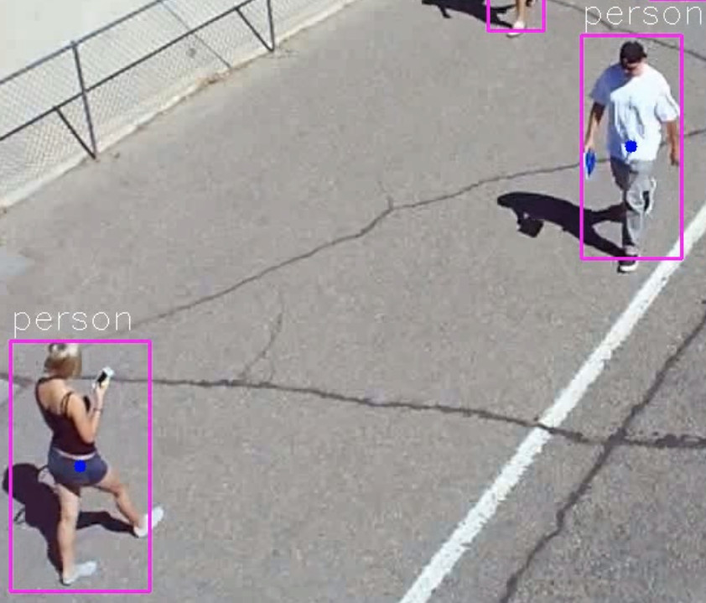
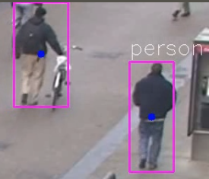
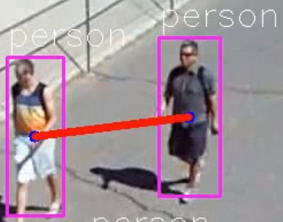
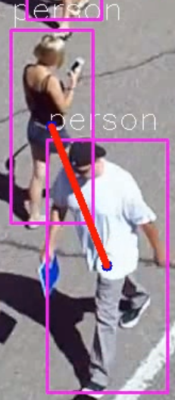
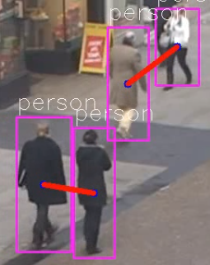
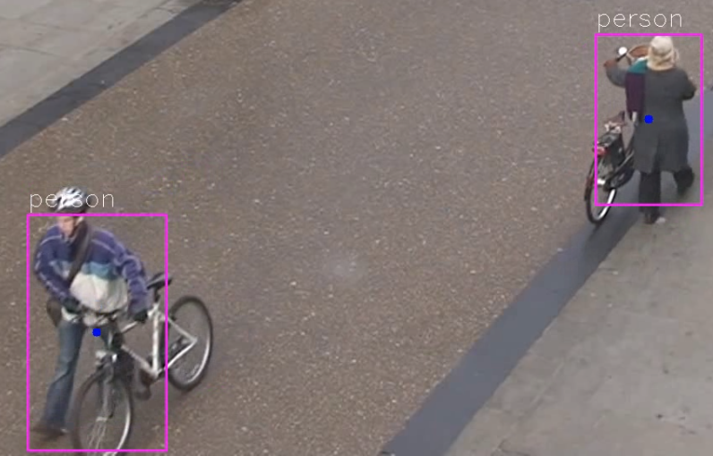
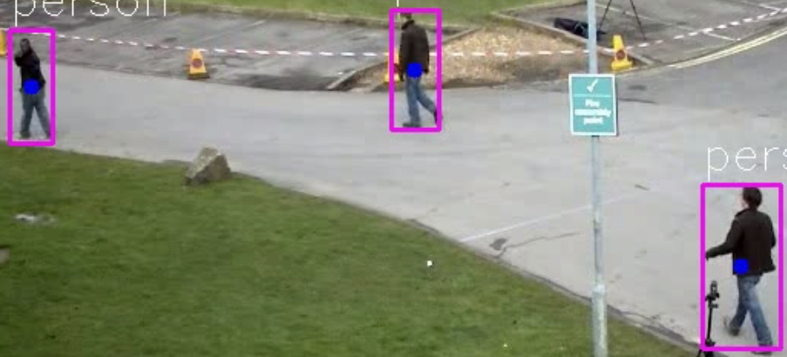
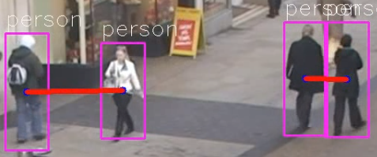
Establish Social Distance
Follows Social Distancing
Do not follow Social Distancing

Slide 8

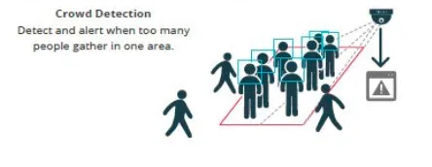
Crowd Detection
Region
Crowd
Region
Credits https://www.atss.in/people-counting-cctv-solutions/

Slide 9
Violator Notifications
Crowd
Region
Region Name | Severity Level
R1 | Low/Moderate/High
R2 | Low/Moderate/High
... | ...
Database (MySQL/AWS Redshift)
Notification Service
SMS/ AWS SNS to Police

Slide 10
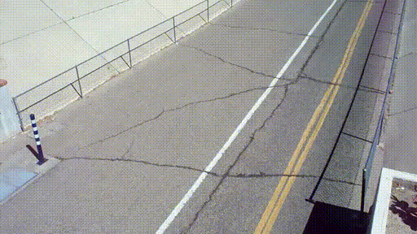
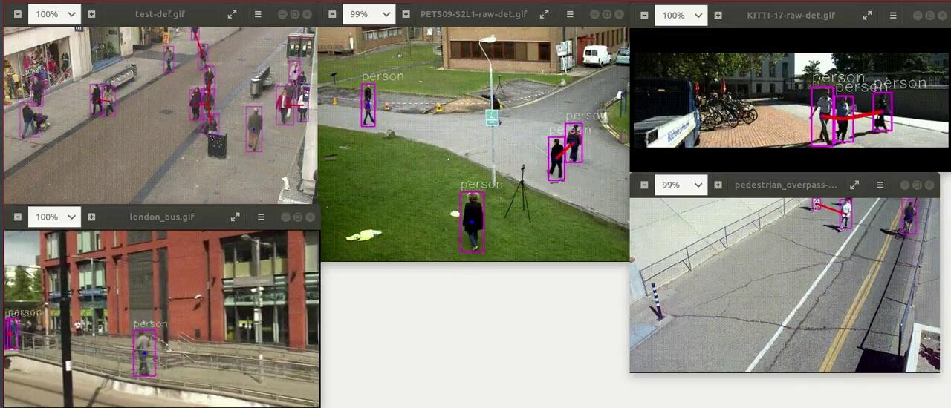
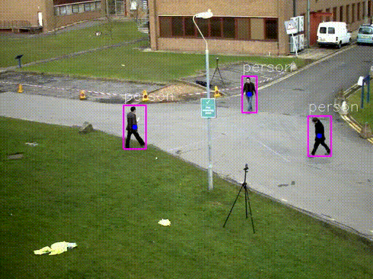
Results

Slide 11
Thank you!

